Slide 1



Cyber-Physical Security Analysis using Bayesian Attack Trees
Rounak MEYUR
December 7, 2018

Slide 2
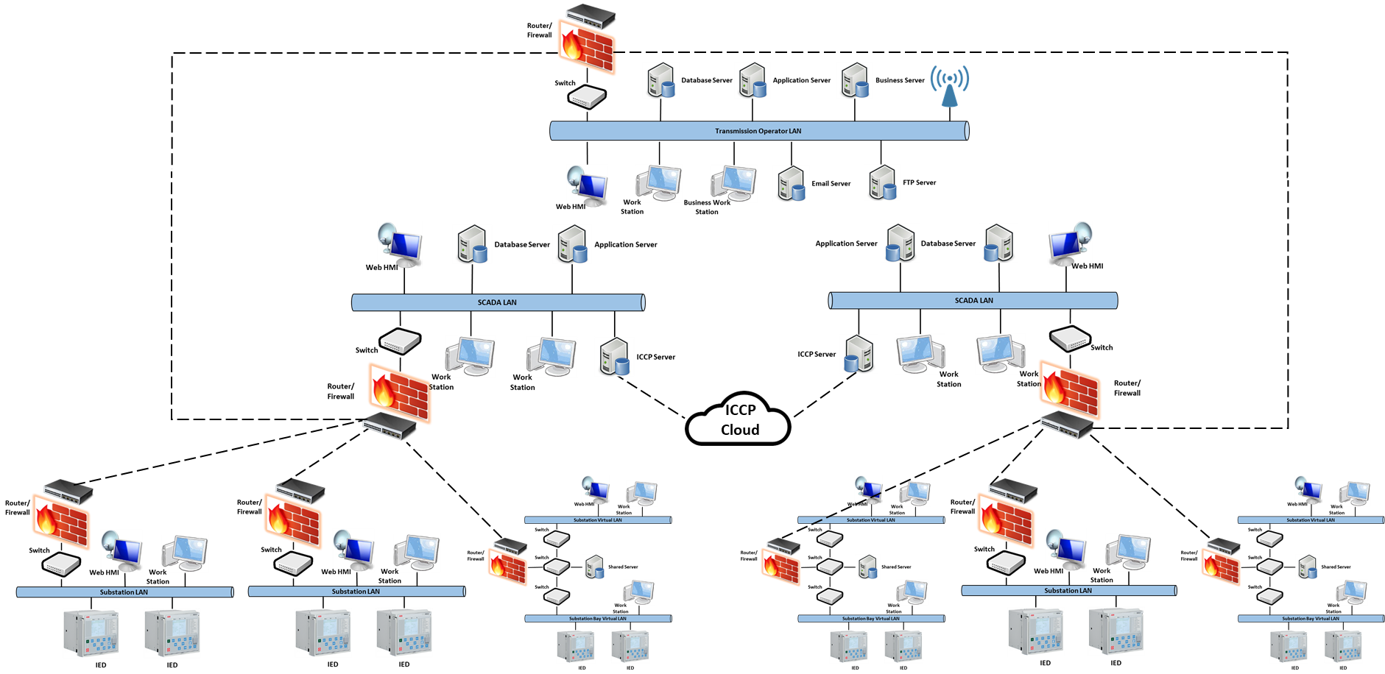
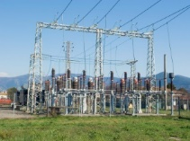
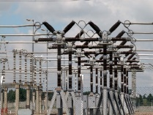
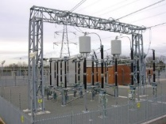

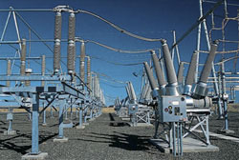
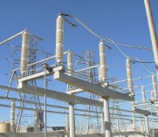
Introduction
MOTIVATION
Power system is identified as a critical infrastructure.
The interconnected SCADA system has made the power system susceptible to cyber vulnerabilities.
RISK ASSESSMENT
Model of the physical power system.
Model of the underlying SCADA system.
Model of the cyber attack.
Proposed risk assessment model
Models intruder attacks aimed to gain access to control elements in the SCADA system.
Models the vulnerabilities in the SCADA system based on the latest vulnerability database.
Models the ability of attacker to exploit vulnerabilities.

Slide 3
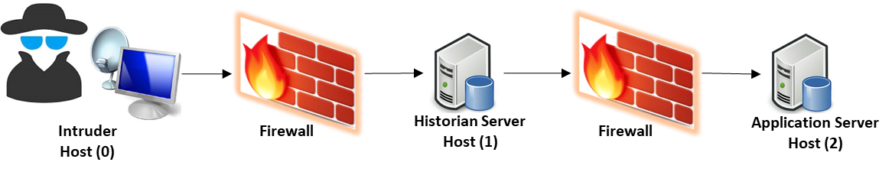
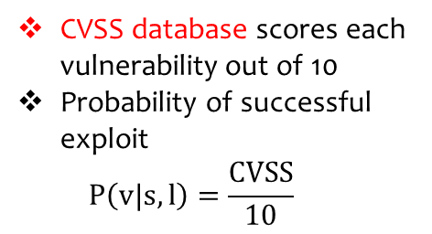
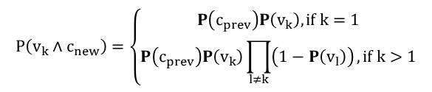
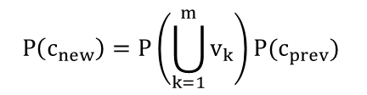
Cyber Attack Model: Bayesian Attack Trees
Cyber Attack Model
Intruder attacks the application server of the control center to get unauthorized administrative access to control assets.
Service: Ser1(1)
Service: Ser3(2)
Service: Ser4(2)
Vulnerability 1
Privilege: user(0)
Privilege: user(1)
Vulnerability 3
Privilege: user(2)
Vulnerability 4
Goal: root(2)
Connection: <0,1>
Vulnerability 2
Service: Ser2(1)
Connection: <1,2>
Connection: <2,2>
Exploiting a vulnerability
Probability of reaching access condition from a given vulnerability
CVSS database scores each vulnerability out of 10
Probability of successful exploit $P\left(v|s,l\right)=\frac{CVSS}{10}$
Access condition from a successful exploit
Vulnerabilities available
$$P\left(c_{new}\right)=P\left(\bigcup_{k=1}^{m}{v_{k}}\right)P(c_{prev})$$
$$P\left(v_{k}∧c_{new}\right)=\left\{\begin{aligned}P\left(c_{prev}\right)P\left(v_{k}\right), if k=1 \\ P\left(c_{prev}\right)P\left(v_{k}\right)\prod_{l≠k}{\left(1−P\left(v_{l}\right)\right)}, if k>1\end{aligned}\right.$$
Zero-day vulnerability
Known vulnerability

Slide 4
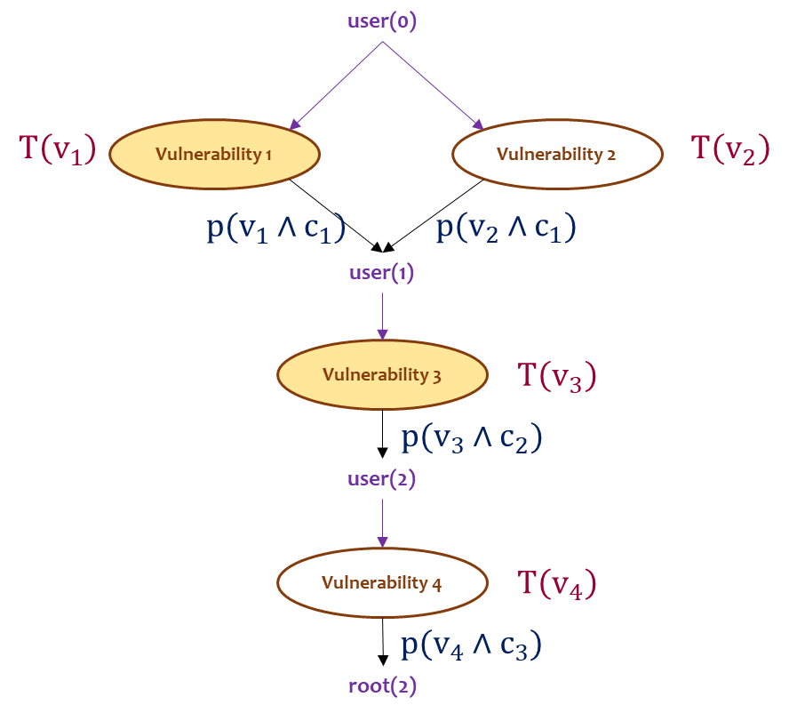


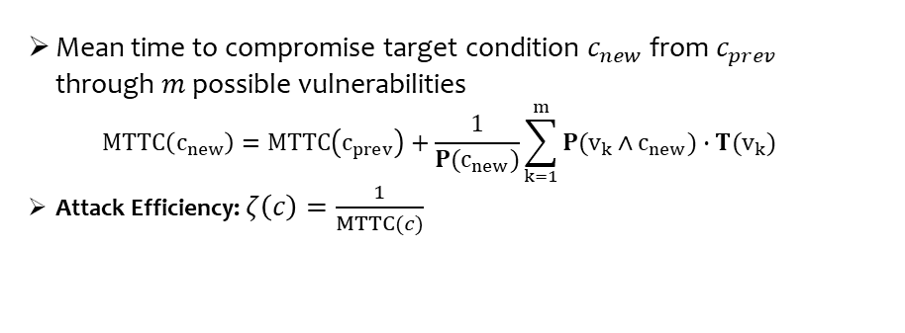
Cyber Attack Model: Mean Time to Compromise
Exploit
Vulnerability
Successful intrusion
Mean time to compromise a vulnerability[Ref]
 | Known vulnerability | Zero-day vulnerability
Known to intruder | 1 day | 32 days
Unknown to intruder | 5.8 days | 65 days
Scale the time by CVSS score.
For unknown vulnerability or code for exploit scale by skill level of intruder
Mean time to compromise target condition $c_{new}$ from $c_{prev}$ through $m$ possible vulnerabilities $MTTC\left(c_{new}\right)=MTTC\left(c_{prev}\right)+\frac{1}{P(c_{new})}\sum_{k=1}^{m}{P(v_{k}∧c_{new})∙T(v_{k})}$
Attack Efficiency: $ζ\left(c\right)=\frac{1}{MTTC(c)}$

Slide 5
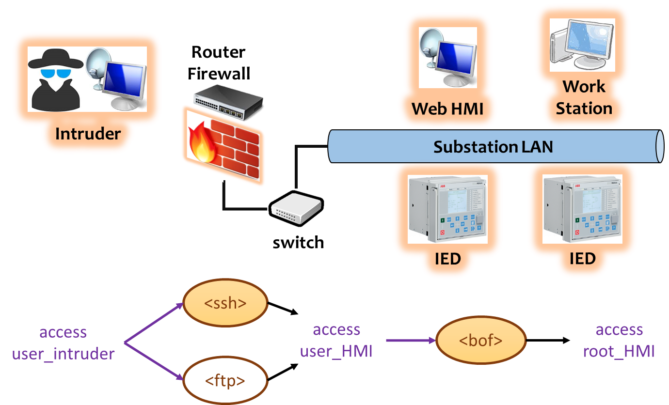
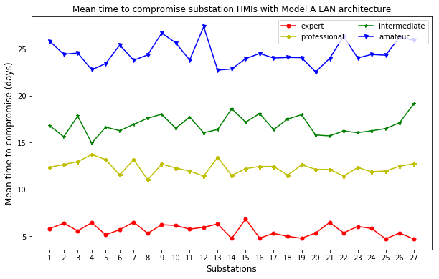
Cyber Attack Model: Substation LAN Model A
An expert intruder takes considerably less time to compromise substation HMIs connected to Model A LAN architecture than less experienced adversaries.

Slide 6
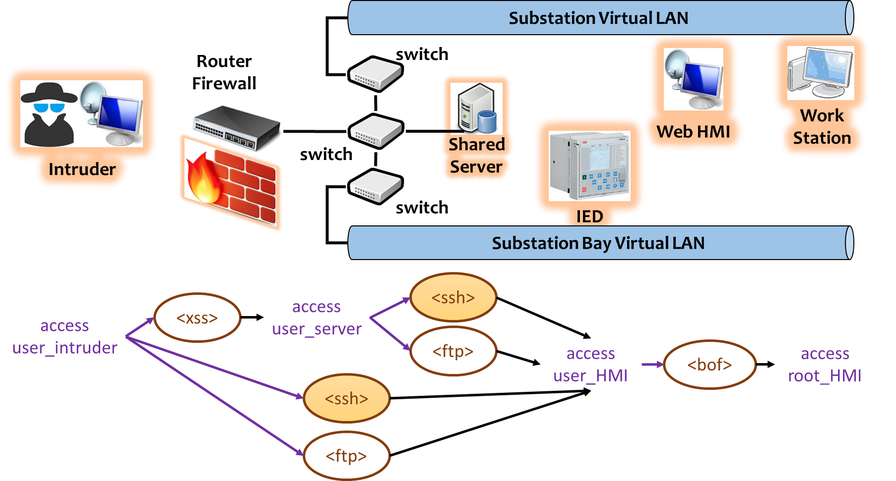
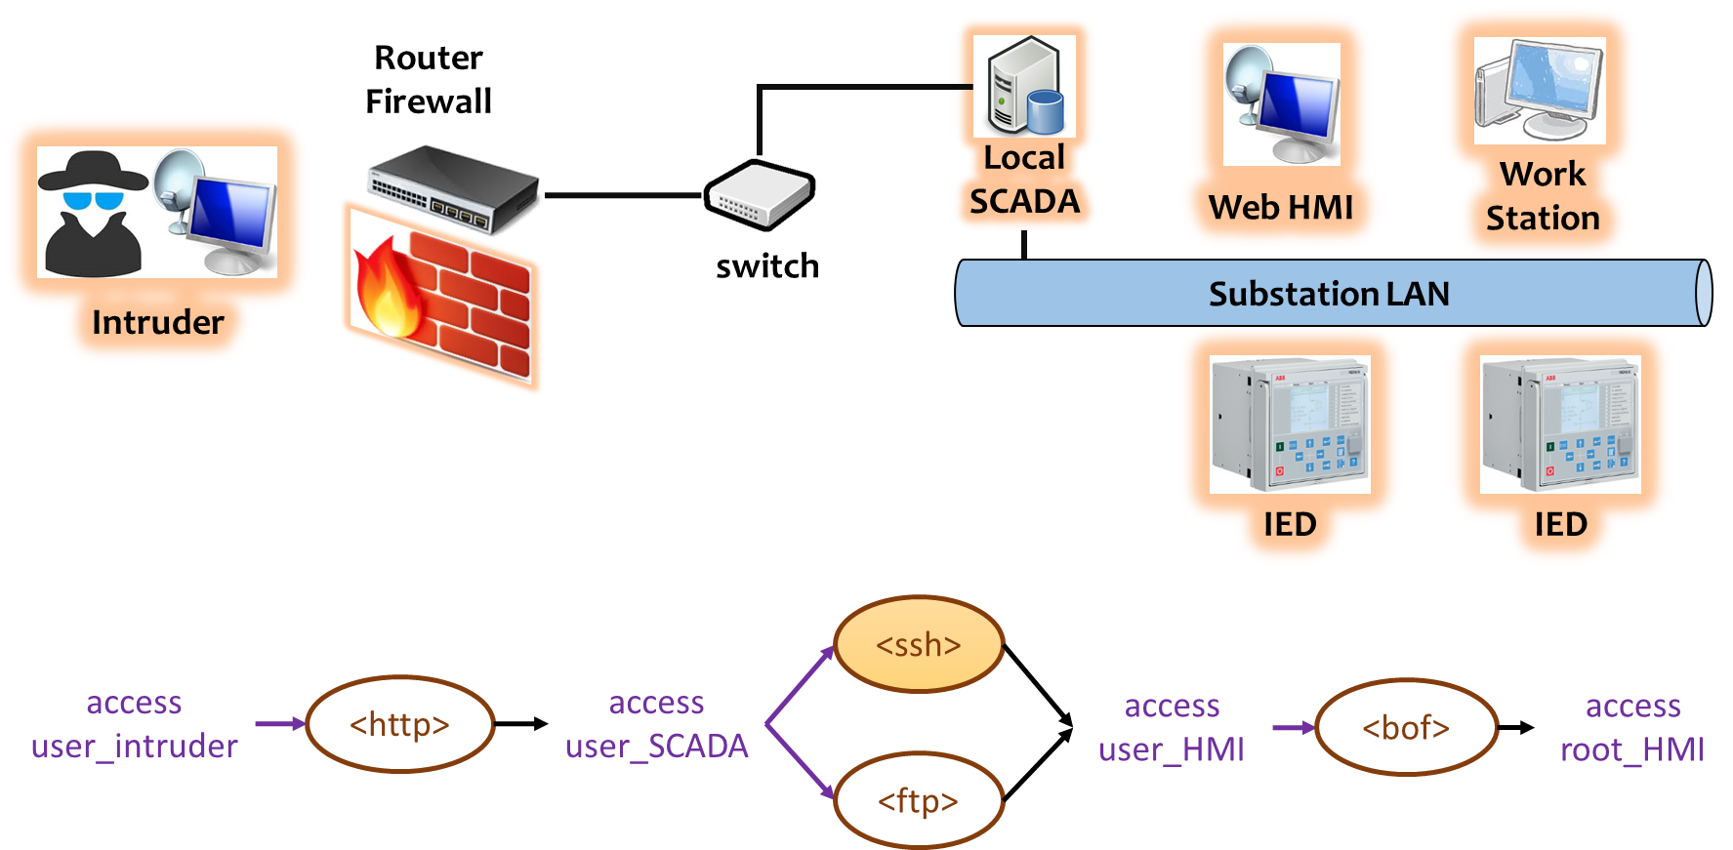
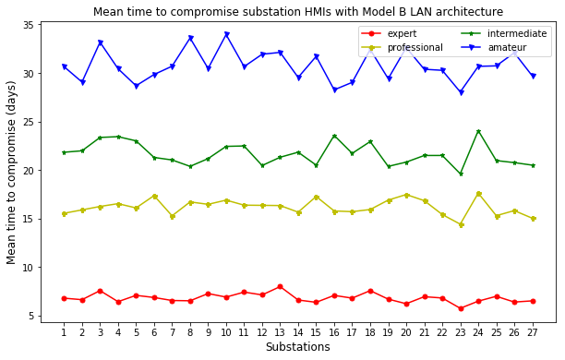
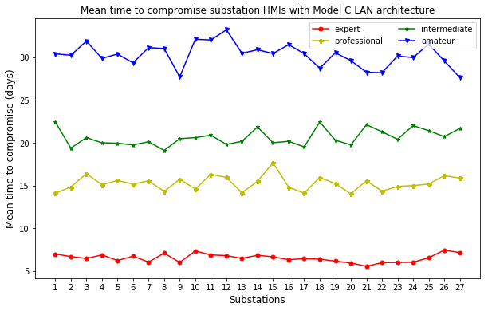
Cyber Attack Model: Substation LAN Models B and C
Model B LAN architecture
Model C LAN architecture

Slide 7
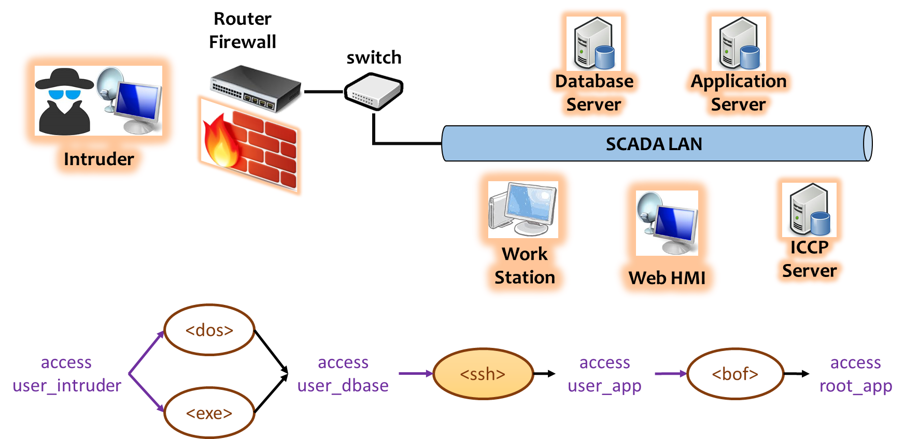
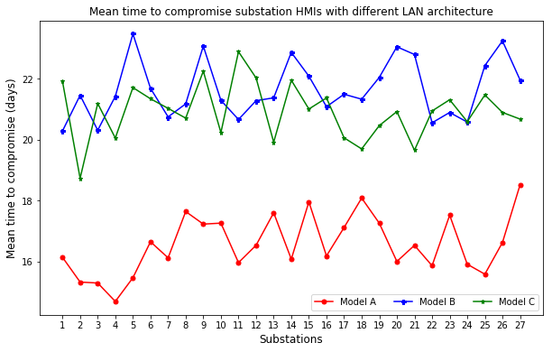
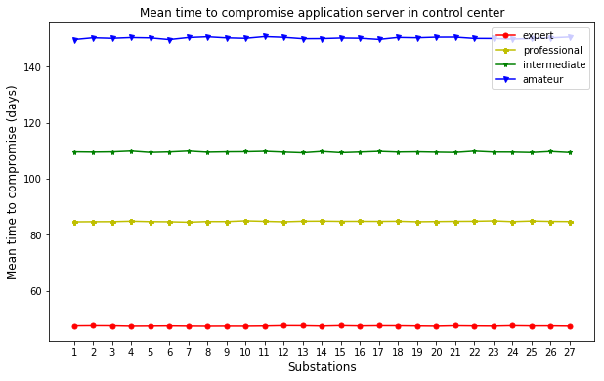
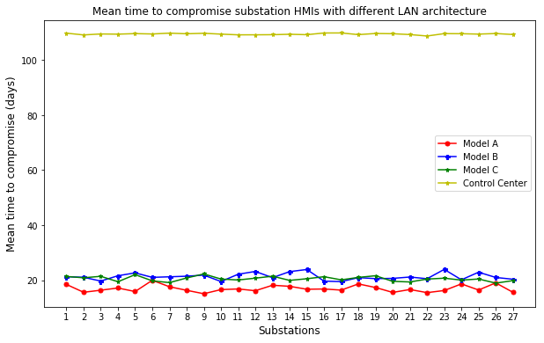
Cyber Attack Model: Control Center SCADA Model
Control center SCADA architecture
Comparison of security level of different cyber architectures

Slide 8
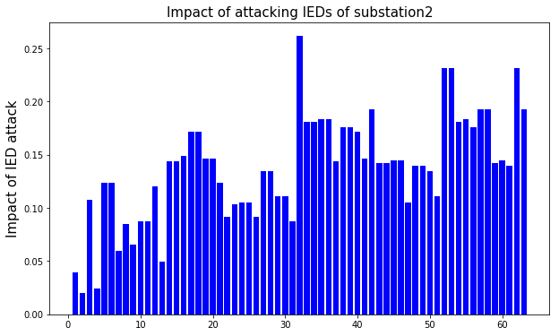
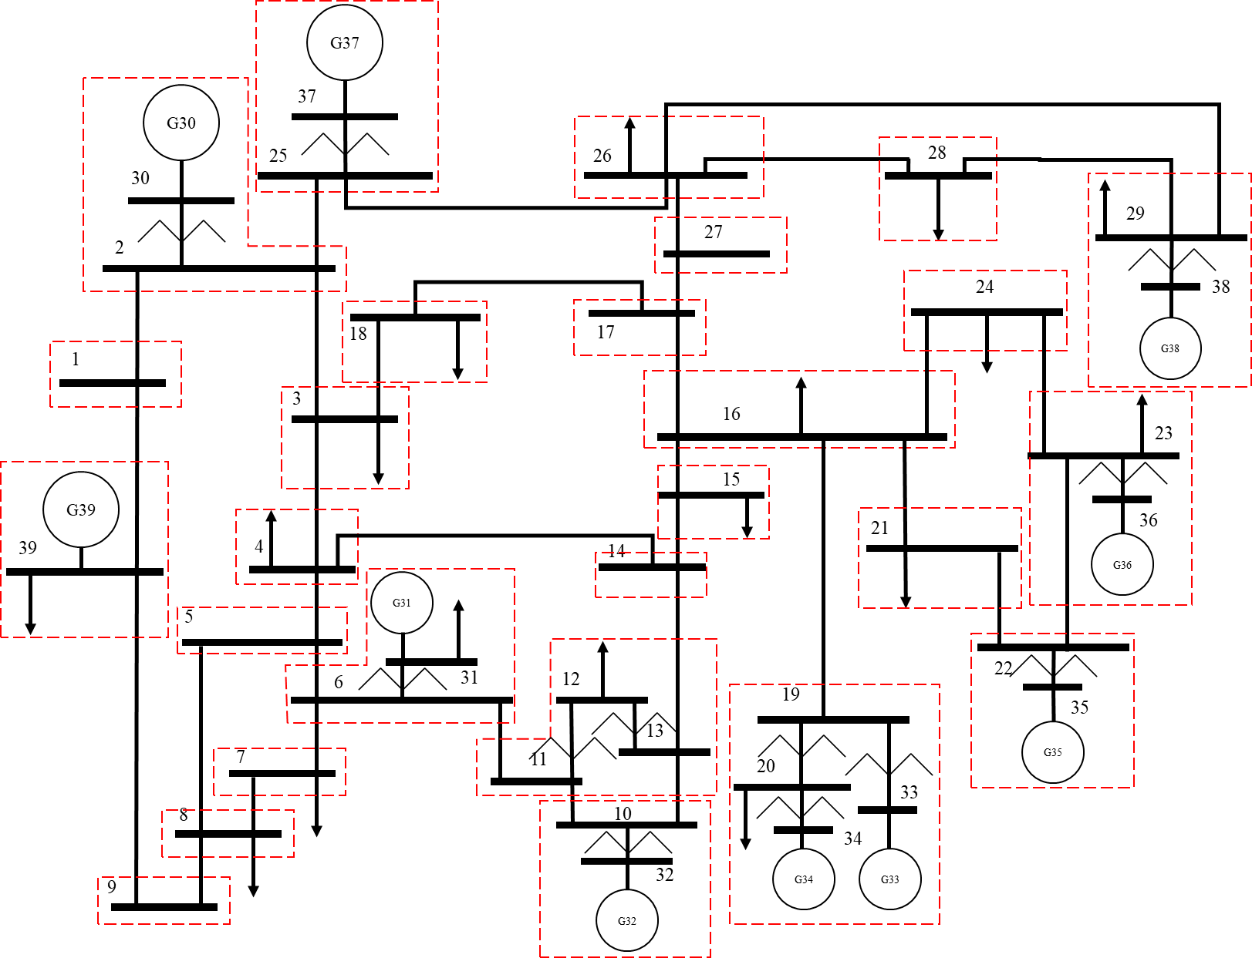
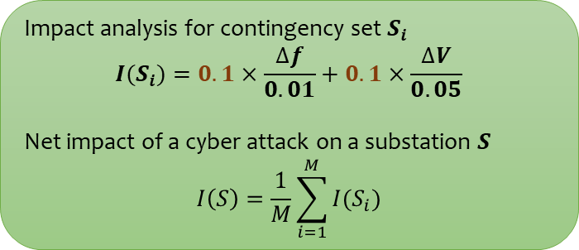
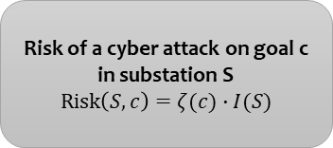
Physical Model: Impact on Power System
Identify substation IEDs
Find target combination of IEDs
Create contingency: open breakers using target IEDs
Run dynamic simulation using PSS/E
Evaluate resulting impact
IED list for Substation 2 (Buses: 2, 30)
Generator G30 circuit breaker.
Transformer 2-30 LV side circuit breaker.
Transformer 2-30 HV side circuit breaker.
Line 2-1 circuit breaker.
Line 2-3 circuit breaker.
Line 2-25 circuit breaker.
Impact analysis for contingency set $S_{i}$
$$I(S_{i})=0.1×\frac{∆f}{0.01}+0.1×\frac{∆V}{0.05}$$
Net impact of a cyber attack on a substation $S$
$$I\left(S\right)=\frac{1}{M}\sum_{i=1}^{M}{I(S_{i})}$$
Risk of a cyber attack on goal c in substation S
$$Risk\left(S,c\right)=ζ(c)∙I(S)$$

Slide 9
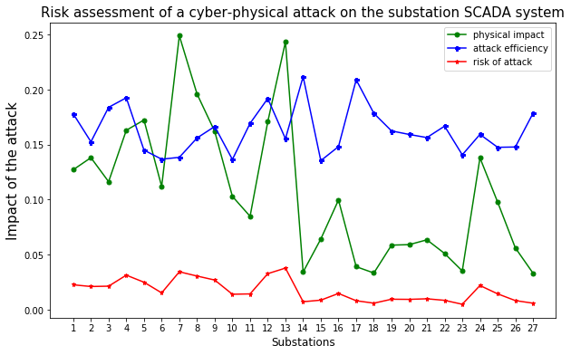
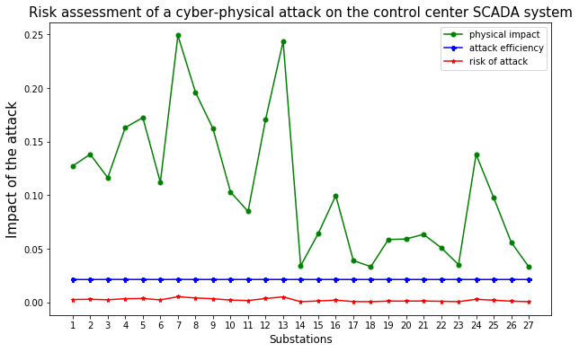
Impact of a Cyber-Physical Attack on IEEE 39-bus Power System

Slide 10
Conclusions
Modeled Bayesian attack trees for substation LAN architectures and control center SCADA system.
Models include possible vulnerabilities in the SCADA system.
Successful exploit of a vulnerability is evaluated from the CVE database of vulnerabilities.
Attack efficiency includes the time to compromise a vulnerability.
Models include the skill level of intruder to estimate the attack efficiency.
Risk analysis of a cyber attack on a power system.
Incorporates the impact on the physical power system when an HMI is compromised.
Incorporates the attack efficiency of the intruder.

Slide 11
References
W. Nzoukou, L. Wang, S. Jajodia and A. Singhal, "A Unified Framework for Measuring a Network's Mean Time-to-Compromise," 2013 IEEE 32nd International Symposium on Reliable Distributed Systems, Braga, 2013, pp. 215-224.
Y. Zhang, L. Wang, Y. Xiang and C. Ten, "Power System Reliability Evaluation With SCADA Cybersecurity Considerations," in IEEE Transactions on Smart Grid, vol. 6, no. 4, pp. 1707-1721, July 2015.
McQueen, M.A., Boyer, W.F., Flynn, M.A., & Beitel, G.A., “Time-to-Compromise Model for Cyber Risk Reduction Estimation”, Quality of Protection, 2006.
Stefanov, A., Liu, C., Govindarasu, M. and Wu, S. (2015), SCADA modeling for performance and vulnerability assessment of integrated cyber–physical systems. Int. Trans. Electr. Energ. Syst., 25: 498–519.
CVE Database of FTP Vulnerability. [Online]. Available: https://www.cvedetails.com/vendor/2/FTP.html
CVE Database of HTTP Vulnerability. [Online]. Available: https://www.cvedetails.com/vendor/45/Apache.html
CVE Database of SSH Vulnerability. [Online]. Available: https://www.cvedetails.com/vendor/120/SSH.html

Slide 12
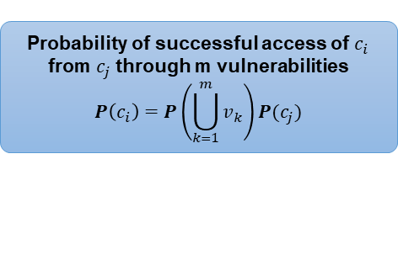
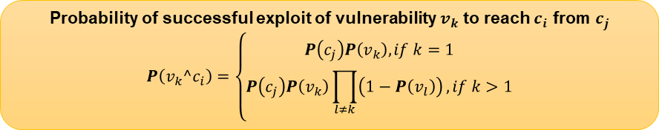
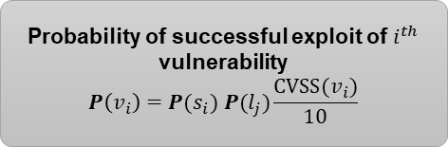
Cyber Attack Model: Bayesian Attack Trees
Cyber Attack Model
Intruder attacks the application server of the control center to get unauthorized administrative access to control assets.
Privilege: user(0)
Connection: <0,1>
Service: Ser1(1)
Service: Ser2(1)
<Ser1, 0, 1>
<Ser2, 0, 1>
Attack Tree Formulation
Each access condition can be reached by exploiting vulnerabilities with prior access condition.
The goal is reached through a set of access conditions.
Privilege: user(1)
Connection: <1,2>
Service: Ser3(2)
<Ser3, 1, 2>
Probability of successful exploit of $i^{th}$ vulnerability
$$P\left(v_{i}\right)=P(s_{i}) P(l_{j})\frac{CVSS(v_{i})}{10}$$
Probability of successful access of $c_{i}$ from $c_{j}$ through m vulnerabilities
$$P\left(c_{i}\right)=P\left(\bigcup_{k=1}^{m}{v_{k}}\right)P(c_{j})$$
Privilege: user(2)
Connection: <2,2>
Service: Ser4(2)
Probability of successful exploit of vulnerability $v_{k}$ to reach $c_{i}$ from $c_{j}$
$$P\left(v_{k}^c_{i}\right)=\left\{\begin{aligned}P\left(c_{j}\right)P\left(v_{k}\right), if k=1 \\ P\left(c_{j}\right)P\left(v_{k}\right)\prod_{l≠k}{\left(1−P\left(v_{l}\right)\right)}, if k>1\end{aligned}\right.$$
<Ser4, 2, 2>
Goal: root(2)

Slide 13


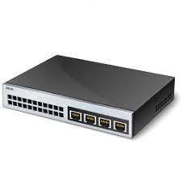

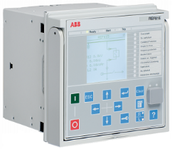

Cyber Attack Model: Substation LAN Model A
Substation LAN
Router
Firewall
Work
Station
Web HMI
Intruder
switch
IED
IED
<ssh>
access
user_intruder
access user_HMI
<bof>
access
root_HMI
<ftp>

Slide 14
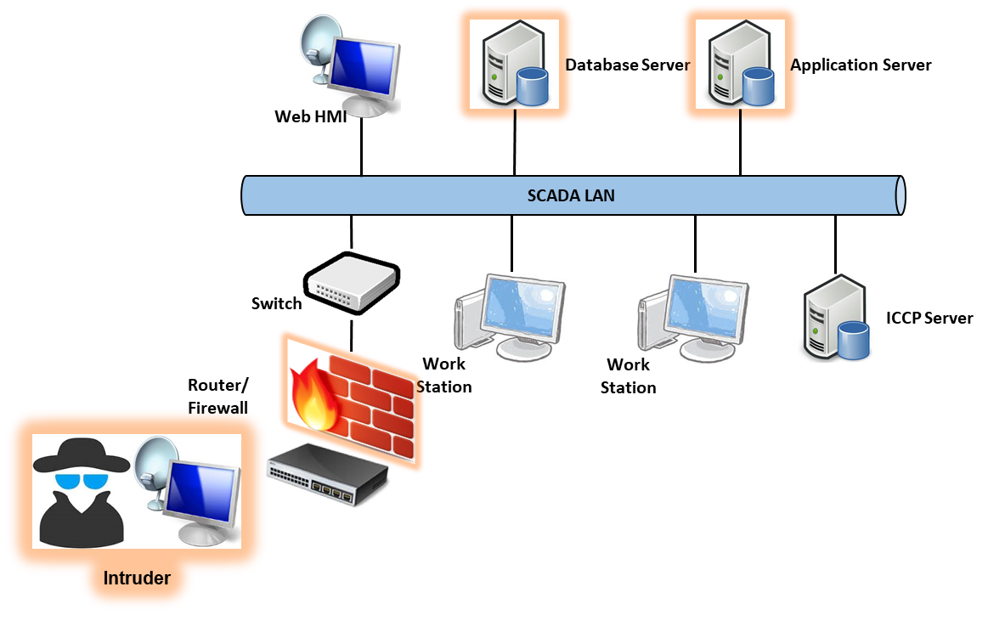
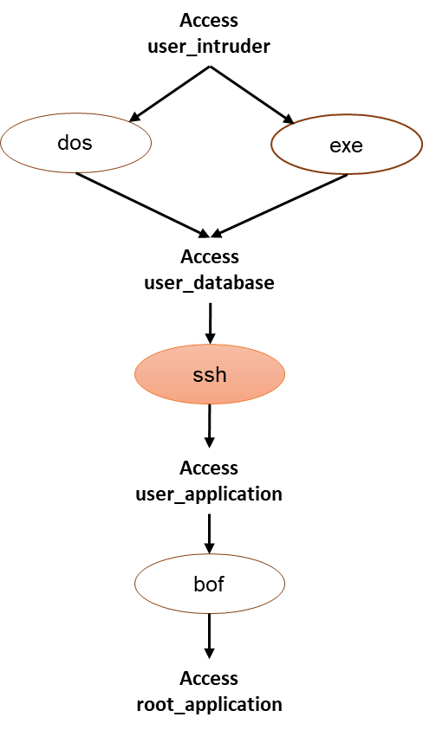
Cyber Attack Model: Control Center SCADA Model
Security comparison of different substation and control center SCADA architectures

Slide 15
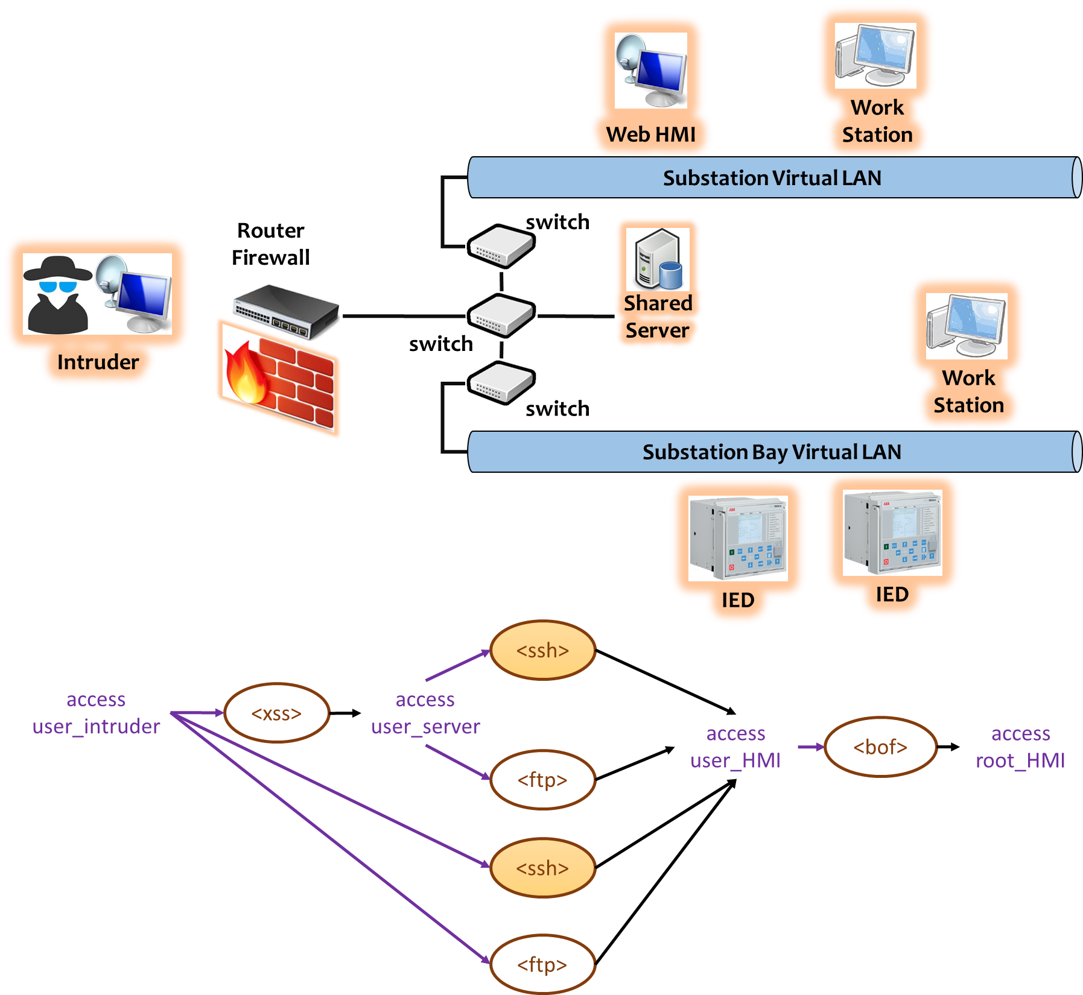
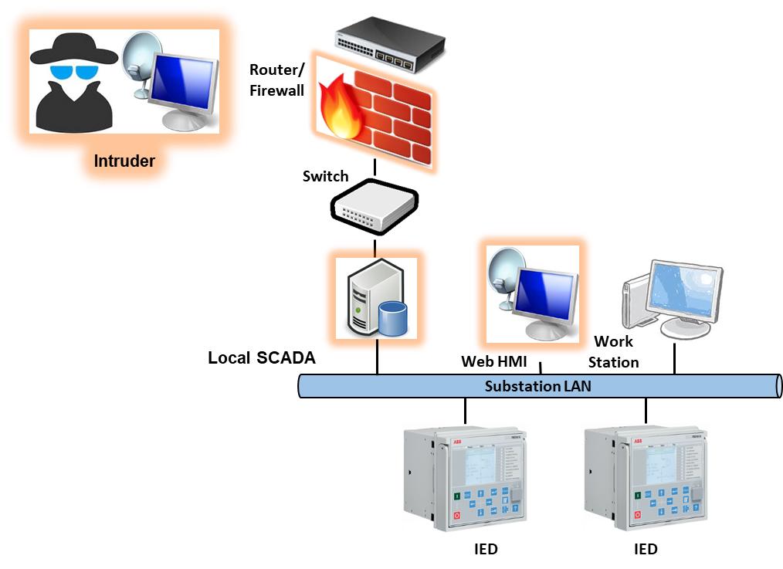
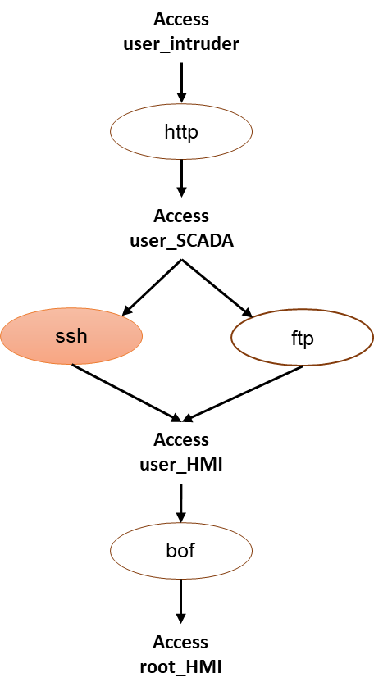
Cyber Attack Model: Substation LAN Models B and C

Slide 16
service
Ser1
T(v₁)
service
Ser3
privilege
user(0)
<Ser1,0,1>
p(v₂Λc₁)
privilege user(1)
<Ser3,1,2>
privilege user(2)
p(v₃Λc₂)
connection
<0,1>
<Ser2,0,1>
p(v₁Λc₁)
connection <1,2>
T(v₃)
T(v₂)
service
Ser2

Slide 17
Substation Virtual LAN
Substation Bay Virtual LAN
Router
Firewall
switch
Work
Station
Web HMI
switch
Shared
Server
Intruder
switch
IED
<ssh>
<xss>
access
user_server
access
user_intruder
<ftp>
access user_HMI
<bof>
access
root_HMI
<ssh>
<ftp>

Slide 18
Substation LAN
Router
Firewall
Local
SCADA
Work
Station
Web HMI
switch
Intruder
IED
IED
<ssh>
access
user_intruder
<http>
access
user_SCADA
access user_HMI
<bof>
access
root_HMI
<ftp>

Slide 19
SCADA LAN
Router
Firewall
switch
Database
Server
Application
Server
Intruder
Work
Station
ICCP
Server
Web HMI
<dos>
access
user_intruder
access user_dbase
<ssh>
access
user_app
<bof>
access
root_app
<exe>

